Slide 1



details
you'd miss in a photo
Everything blue is a guide. Delete it before you download.
Notes:
Slide 1. Hook. Swap in a photo of your product. Move the circle onto a detail.

Slide 2

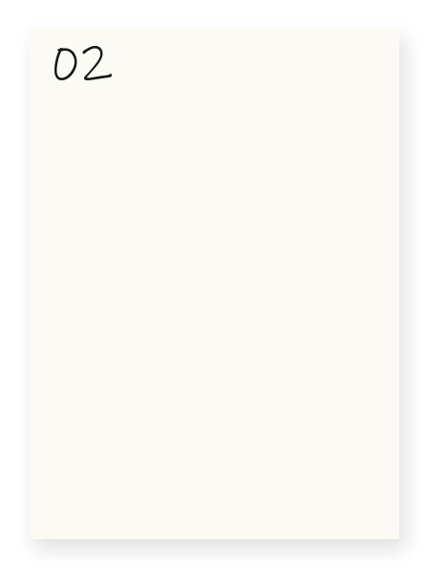

[look closer]
[4 things you
would miss]
Notes:
Slide 2. Second hook: Instagram often shows a carousel starting on slide 2, so this one works as a cover on its own. Two close-ups go in the film frames. Edit both [bracket] lines.

Slide 3

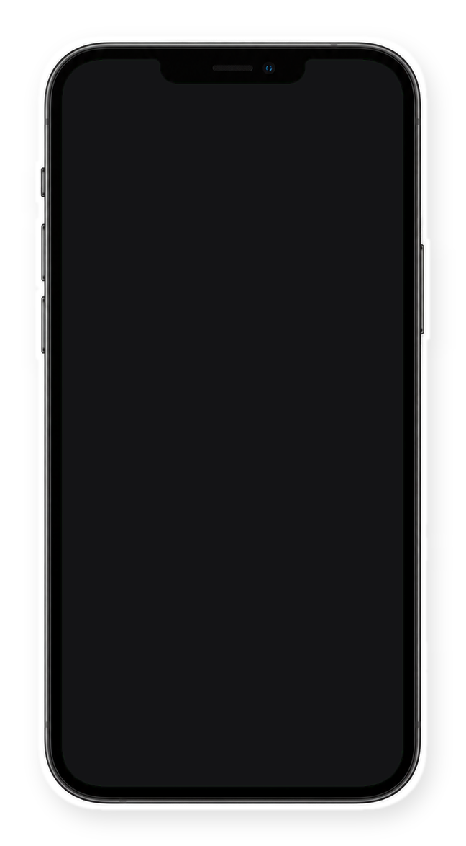


the photo:
looks...
fine?
Notes:
Slide 3. Swap in a screenshot of your listing photo for the phone screen. Edit the note.

Slide 4



up close
[brushed copper finish]
Notes:
Slide 4. Detail 1: a close-up and its name.

Slide 5



[see-through
dust bin]
[one-touch controls]
Notes:
Slide 5. Details 2 and 3: a close-up and a name for each.

Slide 6



[LED head
shows
the dust]
Notes:
Slide 6. Detail 4: a full-page photo. Edit the tag.

Slide 7


now you know
Comment
"[KEYWORD]"
[Product name]
Notes:
Slide 7. Swap in a photo of your product. Type its name and your keyword. Caption to start from (CTA in the first two sentences, 3 hashtags): Comment [KEYWORD] and I will send you [the link]. [One line of real context: who it helps or how you use it.] #[tag] #[tag] #[tag]

